Slide 1
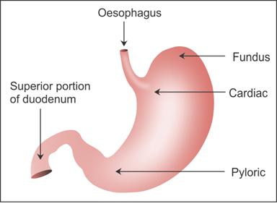
Gross handling of total gastrectomy specimens in patients with the CDH1 mutation that is associated with predictable signet ring cell carcinomas

Slide 2
First, open the specimen along the greater curvature

Slide 3
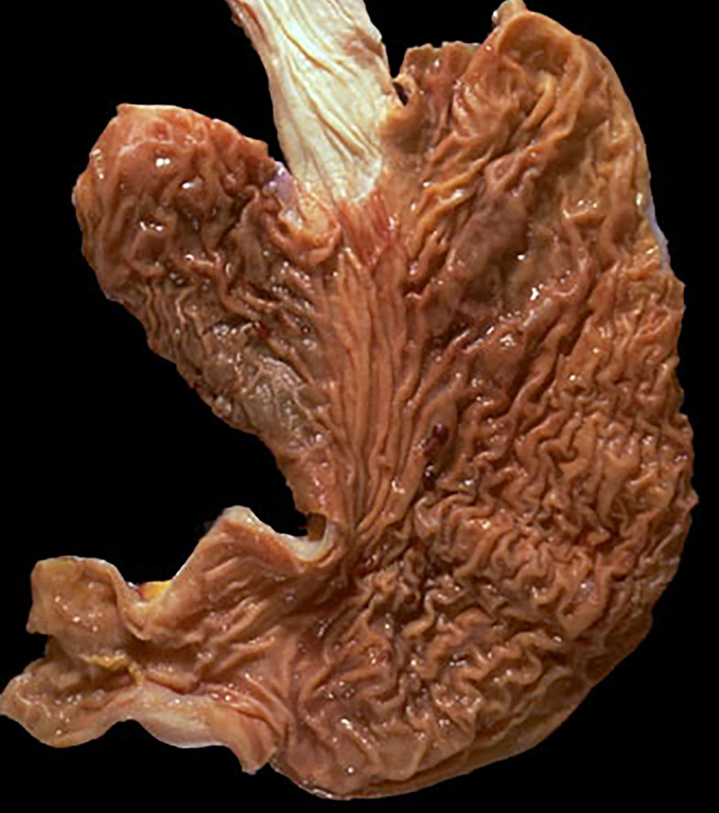
Esophagus
Fundus
Body
Lesser Curvature
Angularis
Antrum

Slide 4
Second, look for any abnormalities such as ulcers, masses, thickenings. If any are found sample them extensively

Slide 5
Third, if there are no abnormalities, take the following longitudinal samples, each about 2 cm long. More than one sample may be put into a single cassette. Make sure that they are flat in the cassette since the complete mucosa needs to be seen microscopically.

Slide 6
3 sections across the esophagogastric junction including the proximal resection margin
3 section from each side of the fundus
3 sections from each side of the body
3 sections along the lesser curvature
3 sections from the antrum

